Slide 1
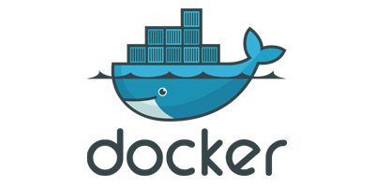
First Steps with:
October 11, 2017

Slide 2
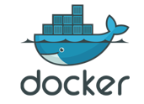
“Old World” Problems
Rickety Software Delivery Pipelines
Different App Behavior in DEV, QA, PROD
Poor Resource Utilization
Only a Few Applications per Machine
Painful Software Administration
Discovery…. Installation…. Dependencies

Slide 3
Solution – Containers!
CONTAINERS ARE:
Isolated Processing Environments
Can include their own network, storage, etc.
Host system houses containers
Purpose: To Run an Application or Service
Includes EVERYTHING – (Small) OS…. Files…. Dependencies
Lightweight
Minimum requirements to run
FAST!!!

Slide 4
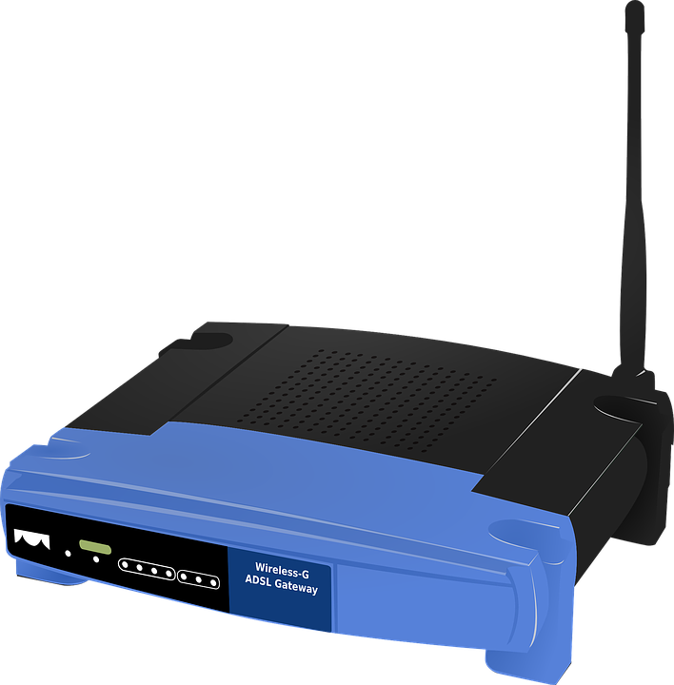

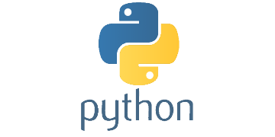

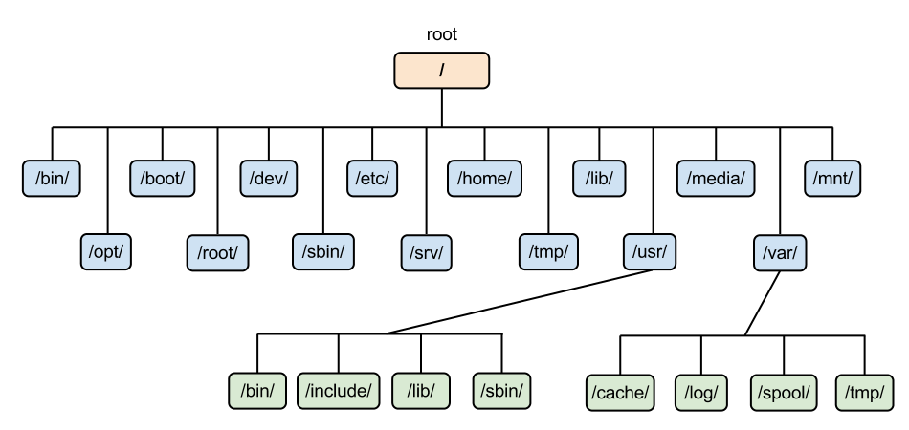
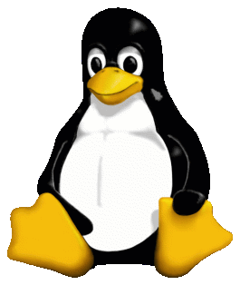
Solution – Containers!
CONTAINERS ARE:
Isolated Processing Environments
Can include their own network, storage, etc.
Host system houses containers
Purpose: To Run an Application or Service
Includes EVERYTHING – (Small) OS…. Files…. Dependencies
Lightweight
Minimum requirements to run
FAST!!!

Slide 5
Containers – Why Use
Predictable DEPLOYMENT Environments
DEV → QA → UAT → PROD
Deployment Types: (1) Blue/Green (2) Rolling (3) Phoenix
Efficient PRODUCTION Environments
Run More Applications on a Machine
Manage Highly-Elastic Applications
Effective DEVELOPMENT Environments
Easy Software Install and Admin / Configuration
Speedy Sandboxes

Slide 6
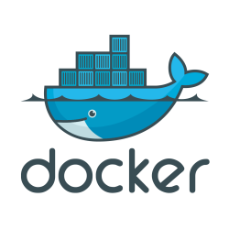
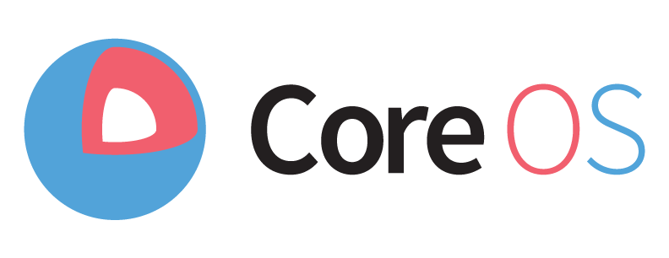

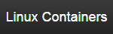
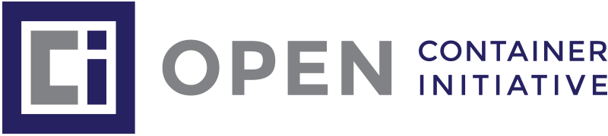
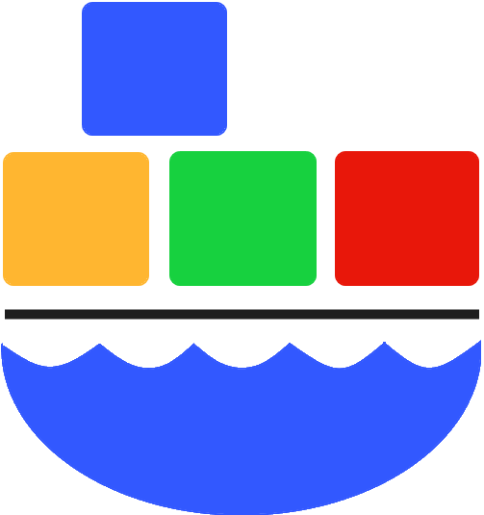
Containers Landscape
1
4
Leading Container Platform
Est. 2013
Container-Specific Operating System
2
Formerly, LXC
5
3
Windows 10
Windows Server 2016
Industry Standards
Avoid Vendor Lock-In
(Windows Containers)

Slide 7
Containers Landscape
1
4
Leading Container Platform
Est. 2013
Container-Specific Operating System
New Name: “Container Linux”
2
Formerly, LXC
5
3
Windows 10
Windows Server 2016
Industry Standards
Avoid Vendor Lock-In
(Windows Containers)

Slide 8
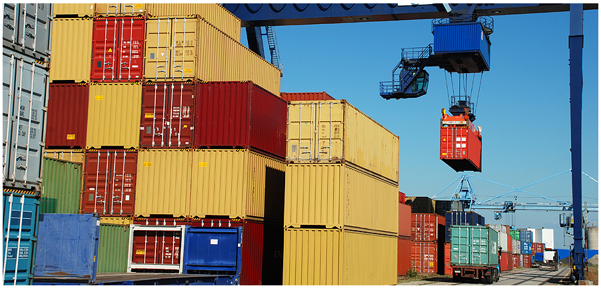
What Is Docker?
Creates, Manages and Orchestrates Containers
Separate Applications from Infrastructure
Better… Faster Software Deployment
Packages an Application → Shippable (and Runnable) Image
“Build, ship, and run any app, anywhere”
Applications work the same on everyone’s machines
Docker:
“Dock Worker” moves goods into/out of ships

Slide 9
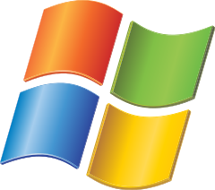
What Is Docker?
Creates, Manages and Orchestrates Containers
Separate Applications from Infrastructure
Better… Faster Software Deployment
Packages an Application → Shippable (and Runnable) Image
“Build, ship, and run any app, anywhere”
Applications work the same on everyone’s machines
Docker:
“Dock Worker” moves goods into/out of ships

Slide 10
What Is Docker?
3 Faces of Docker:
Docker (The Company – Docker, Inc.)
Formerly, a PaaS Provider called dotCloud
In 2013, Pivoted to Focus on its Container Software
Open-Source Project (Renamed, “Moby”)
Make Docker More Modular and Transparent
Run-time and Orchestration Engine
3rd Party Products Plug into the Docker Engine
Community (Free) and Enterprise (Paid) Editions

Slide 11
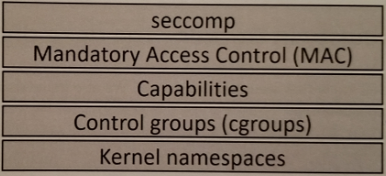
Enabling Technologies
Kernel Namespaces
Slice up an OS to look like multiple isolated environments (Process, Network, File System)
Control Groups
Limit Resource Usage (CPU, RAM, Disk I/O)
Capabilities
Choose which ROOT powers a container needs

Slide 12
Why Did Docker “Win”?
Software Administration Lifecycle…. EASY!
Docker Hub and Official Registries
Establishes trust in images
Modular and Platform-Agnostic Design
“Batteries Included… But Removable”
Free and Open Source

Slide 13
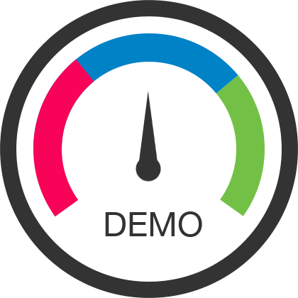
To The Terminal!
1. GENERAL

Slide 14
Docker – Architecture

Slide 15

Docker – Architecture

Slide 16

Docker – Architecture

Slide 17
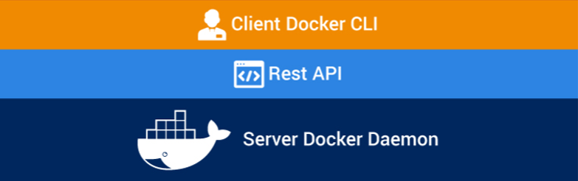
Docker – Architecture

Slide 18

Docker – Architecture

Slide 19
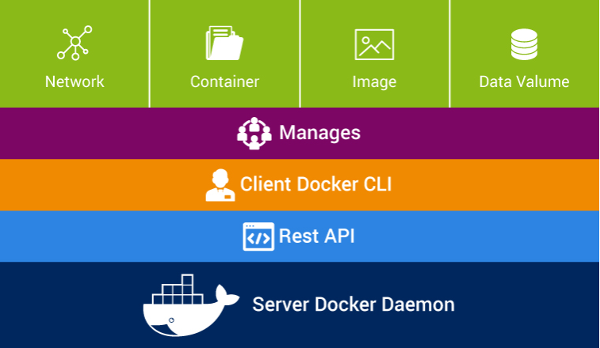
Docker – Architecture

Slide 20
Docker Concepts
Engine | Coordinates all of the Docker components
Images | Core artifact of Docker…. Binaries (“Build”)
Containers | Launched from images …. Running applications (“Deploy”)
Dockerfiles | Readable code for image creation (“Source Code”)
Registries | Collection of repositories (which store images)

Slide 21
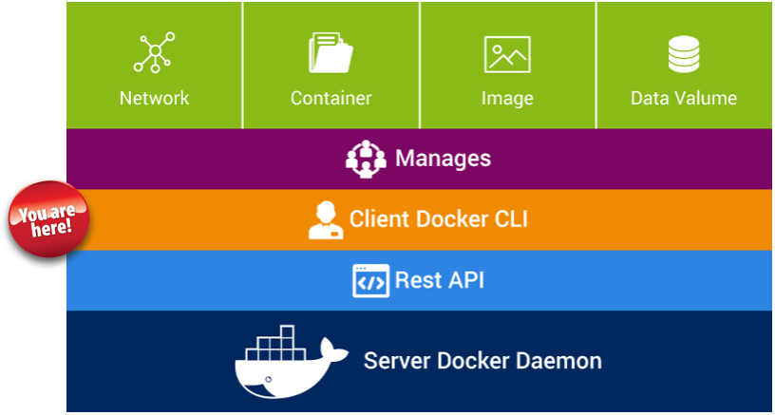
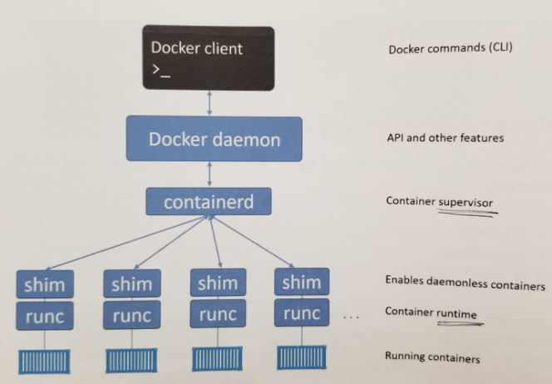
Engine
Docker Client
CLI tool that invokes Docker API calls
Docker daemon
Formerly a Monolith… Now, just the Docker API
containerd
Bridge b/w (1) Docker daemon and (2) runc
Container Lifecycle
runc
Single Purpose → Create Containers

Slide 22
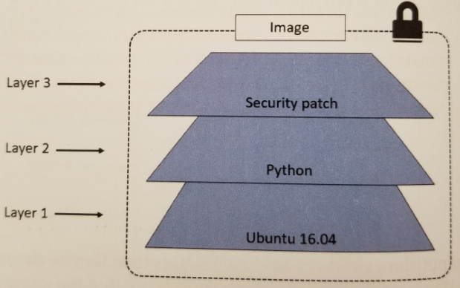
Images
Application Packaged in a Standard, Portable File
(1) Small OS …. (2) And ALL Files to Run App …. (3) Metadata
Stack of Read-Only Layers (Crypto Hashed)
PULL Images onto Your Docker Host
OR… Create Images from (a) Dockerfiles or (b) Containers
“Build-Time” Artifacts
docker image pull
docker image ls
docker image rmi
docker image tag

Slide 23
To The Terminal!
2. IMAGES

Slide 24
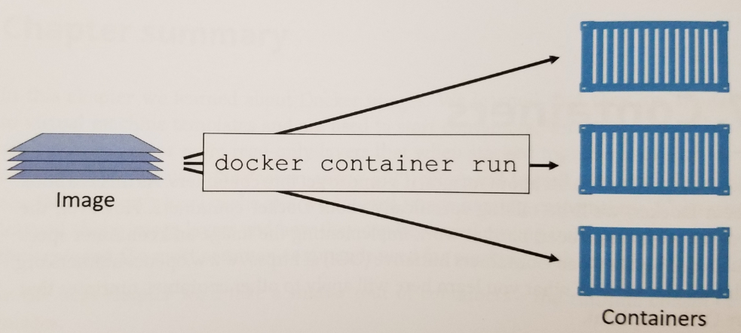
Containers
YOUR RUNNING APPLICATION!
Isolated Group of Processes
Private Root File System…. Network Stack…. Process Tree
Unaware They Are Containers
Spawned from Images
Run Until They Finish Executing
“Run-Time” Artifacts
docker create
docker start
docker stop
docker run
docker exec
docker rm

Slide 25
To The Terminal!
3. CONTAINERS

Slide 26
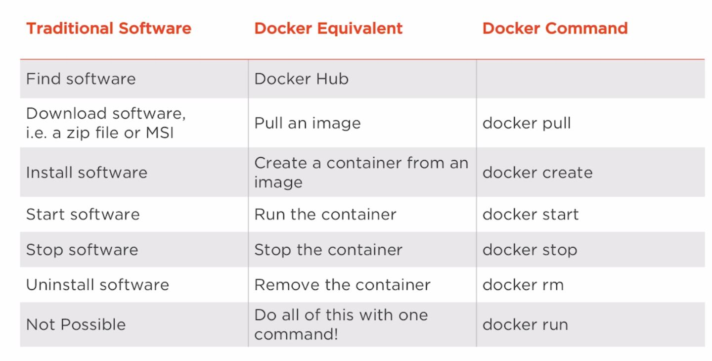
Containers – Easy Software Admin.

Slide 27
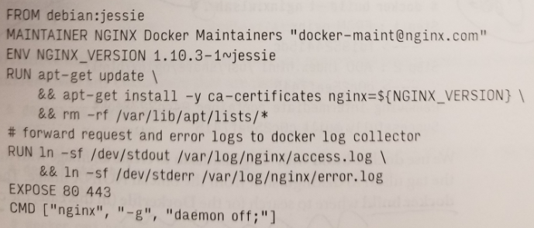
Dockerfiles
Recipes for Building Images
Instructions and Shell Commands
First Instruction Specifies a Base Image
Each Command Creates a New Layer
Source Code Artifact
Store in Version Control!!

Slide 28
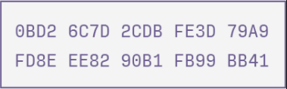
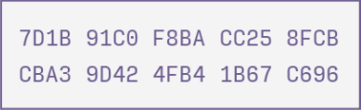
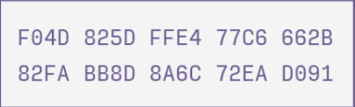
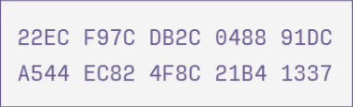
Dockerfiles
Recipes for Building Images
Instructions and Shell Commands
First Instruction Specifies a Base Image
Each Command Creates a New Layer
Source Code Artifact
Store in Version Control!!
New
Image Layers

Slide 29
Dockerfiles
Recipes for Building Images
Instructions and Shell Commands
First Instruction Specifies a Base Image
Each Command Creates a New Layer
Source Code Artifact
Store in Version Control!!
New
Image Layers

Slide 30
To The Terminal!
4. DOCKERFILE

Slide 31
Registries
Index of Docker Images
Accessible by dockerd via HTTP
Docker Hub = Hosted Registry by Docker, Inc.
Public and Private Repositories
Official vs. No-name
Other Public Registries Include:
Amazon ECR
Google Container Registry
quay.io
Private Registries for Sensitive Images

Slide 32
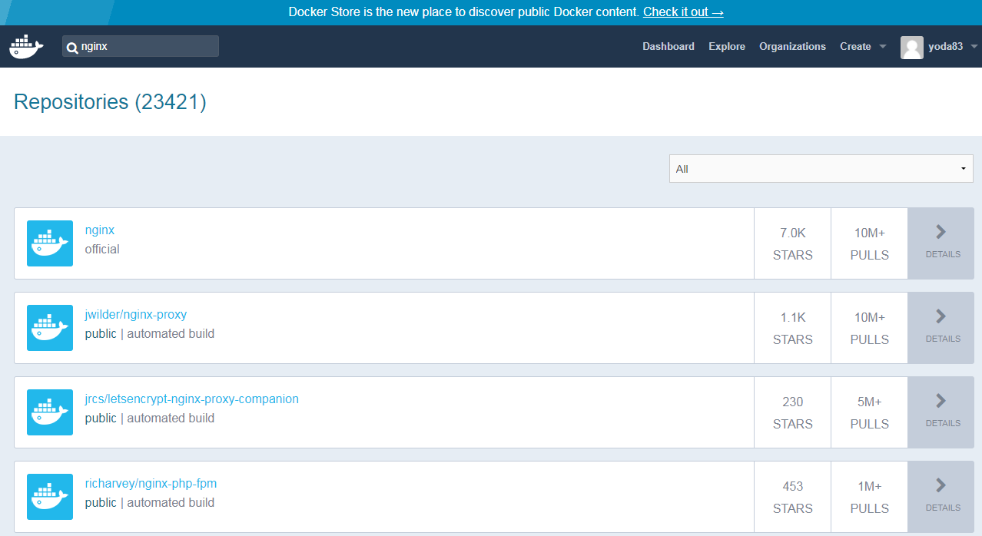
Registries

Slide 33
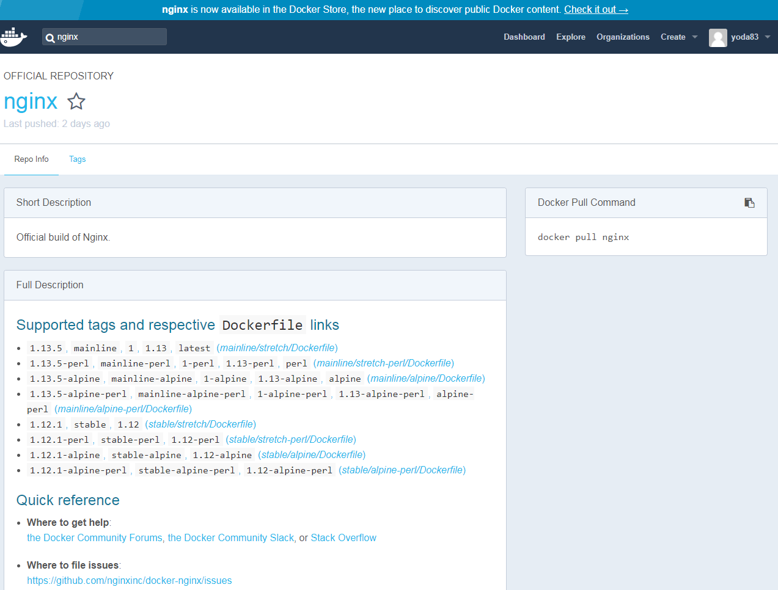
Registries

Slide 34
To The Terminal!
search

Slide 35
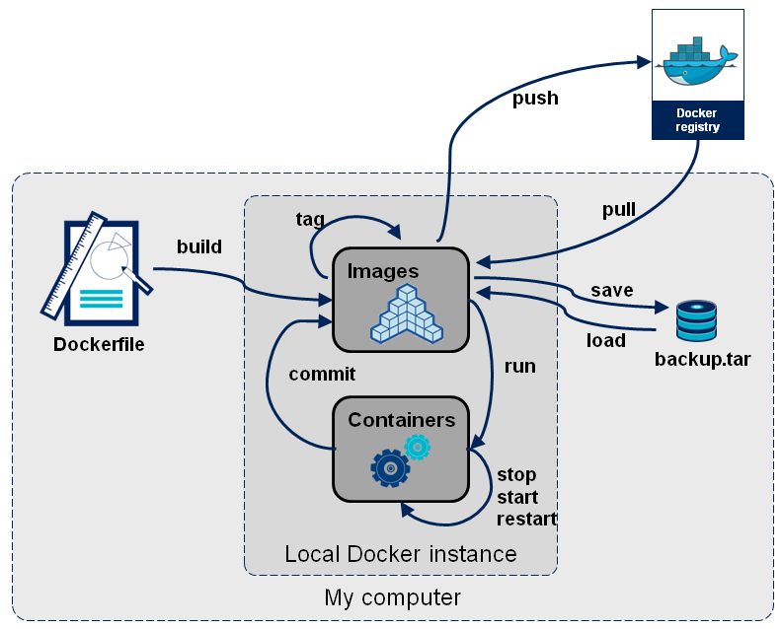
Docker Flow

Slide 36
Docker Flow
1
3
2

Slide 37
Docker Flow
1
3
2

Slide 38
Docker Flow
1
2

Slide 39
Docker Flow
1
2

Slide 40
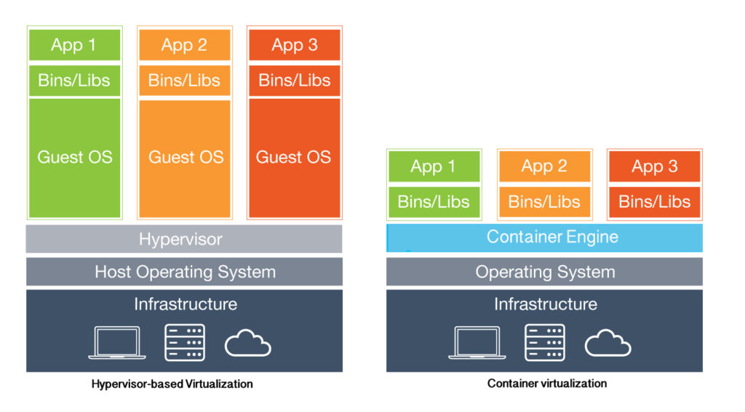
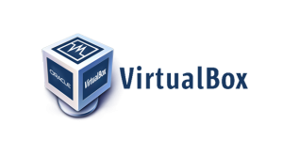

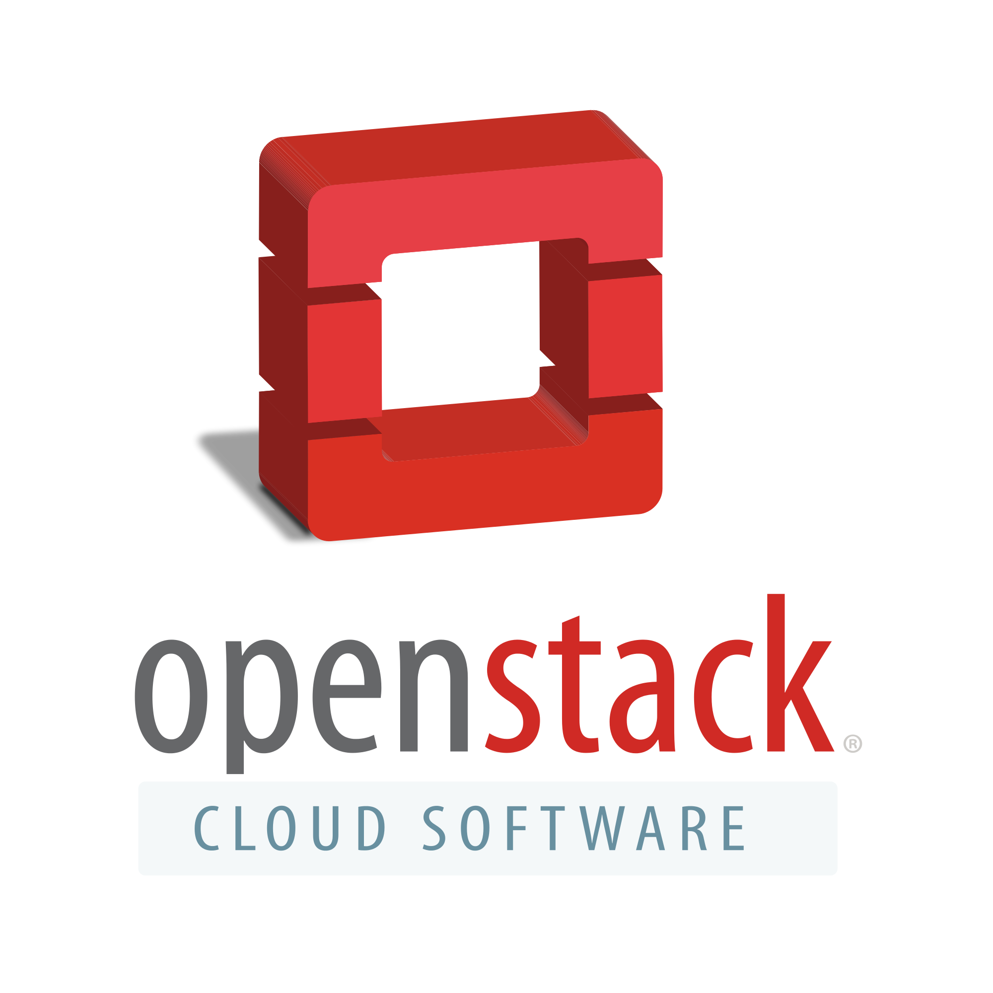
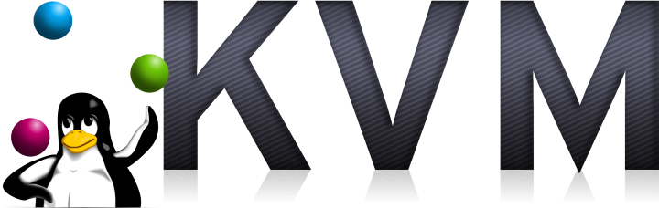

Containers vs. VM’s
Virtual Machines
Rely on Hypervisor
Carve up HARDWARE resources
Bring their own Operating System
Slower and Heavier than Containers

Slide 41
Docker in the Software Stack

Slide 42
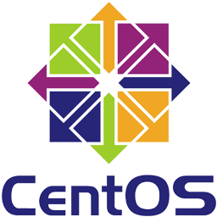
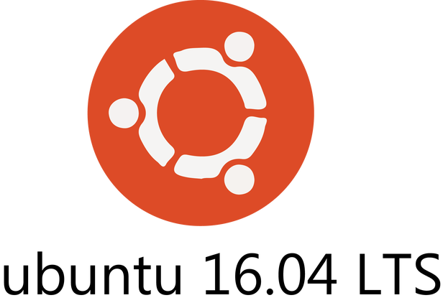
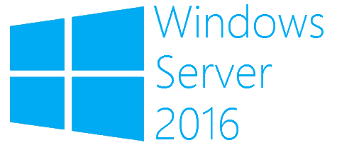
Docker in the Software Stack
1. Base Image
~ Virtual Machines… AMI’s

Slide 43
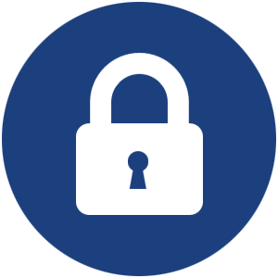

Docker in the Software Stack
2. Custom Image
~ “Hardened” AMI’s
1. Base Image
~ Virtual Machines… AMI’s

Slide 44
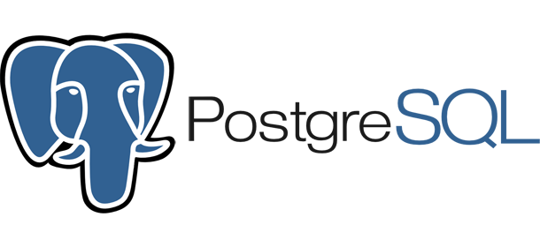
Docker in the Software Stack
3. Base Application
~ Software Tools (Generic)
2. Custom Image
~ “Hardened” AMI’s
1. Base Image
~ Virtual Machines… AMI’s

Slide 45

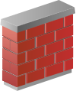
Docker in the Software Stack
4. Base Configuration
~ Software Tools Wired Up
3. Base Application
~ Software Tools (Generic)
2. Custom Image
~ “Hardened” AMI’s
1. Base Image
~ Virtual Machines… AMI’s

Slide 46
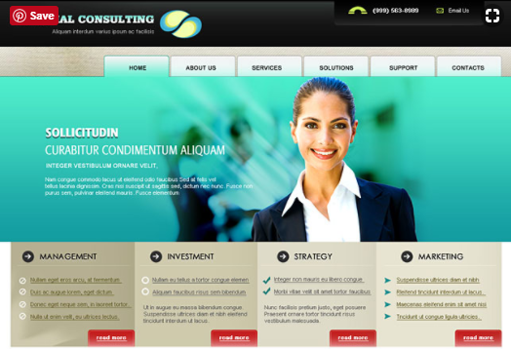
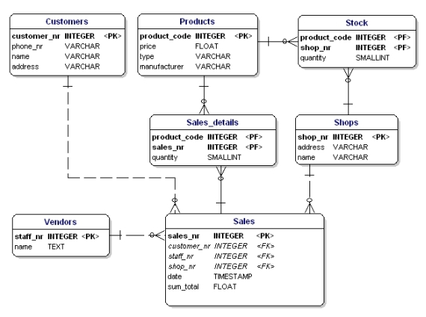
Docker in the Software Stack
5. Custom Application
~ Your Logic; Algorithms
4. Base Configuration
~ Software Tools Wired Up
3. Base Application
~ Software Tools (Generic)
2. Custom Image
~ “Hardened” AMI’s
1. Base Image
~ Virtual Machines… AMI’s

Slide 47
Docker in the Software Stack
5. Custom Application
~ Your Logic; Algorithms
4. Base Configuration
~ Software Tools Wired Up
3. Base Application
~ Software Tools (Generic)
2. Custom Image
~ “Hardened” AMI’s
1. Base Image
~ Virtual Machines… AMI’s

Slide 48
To The Terminal!
6. PROCESS ISOLATION

Slide 49
Container Mgmt
WHO MANAGES:
Container Sprawl?
Container Orchestration?
Container Failure and Recovery?

Slide 50
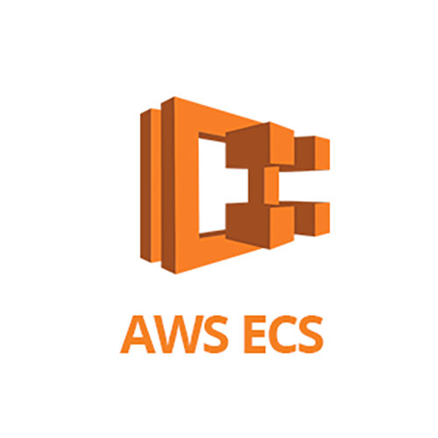
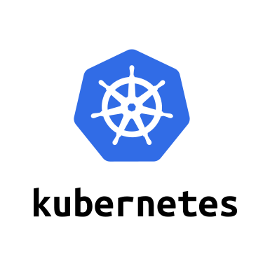
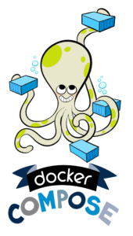
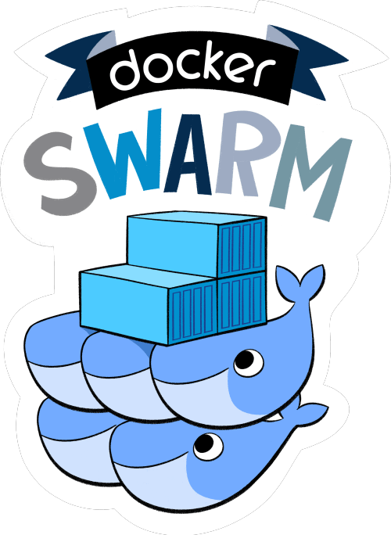
Container Mgmt
SERVICES INCLUDE:
Initial Launch
Service Discovery
Fault-Tolerance
Horizontal Scalability
1
2
3
4

Slide 51
Docker Ecosystem

Slide 52
Docker Ecosystem
Container Engine
Cluster and Scheduling Tool for Docker Containers
Define and Run Multi-Container Docker Applications

Slide 53
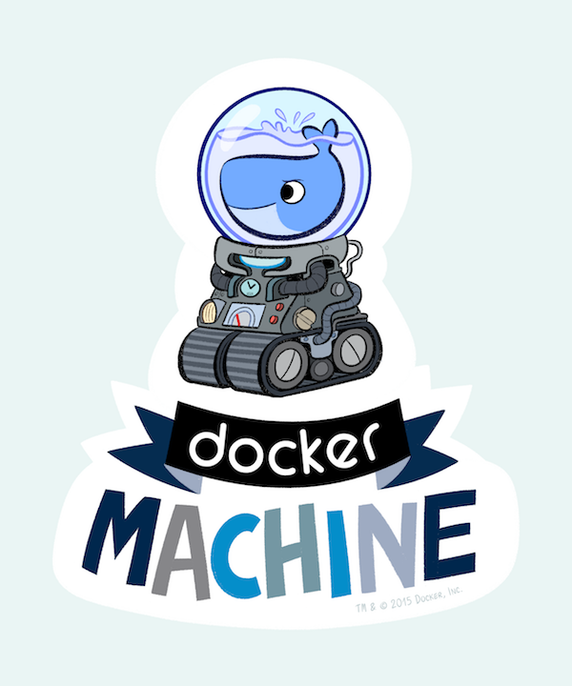
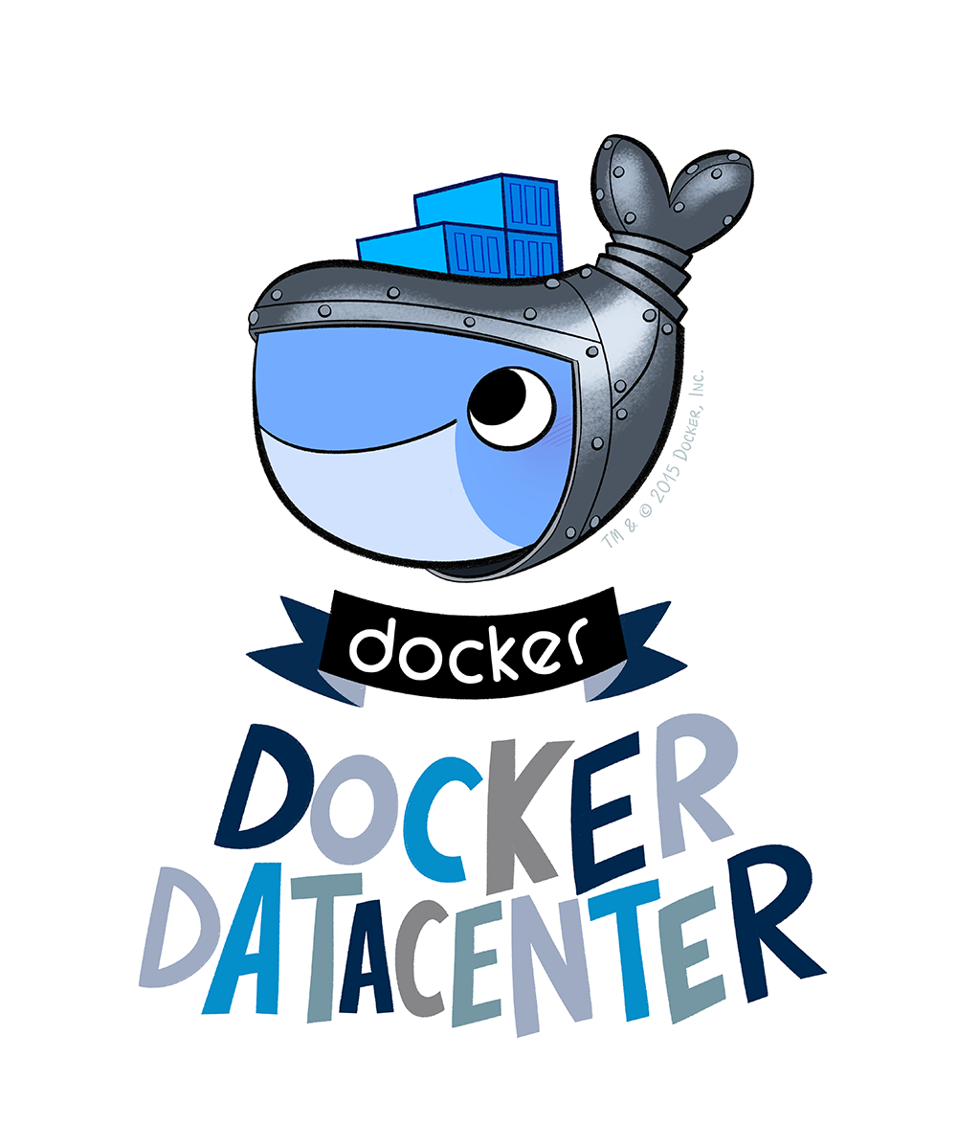
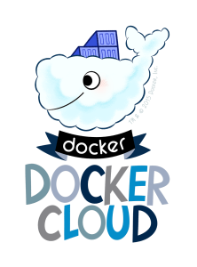
Docker Ecosystem
Container Engine
Manage Virtual Docker Hosts Remotely
Cluster and Scheduling Tool for Docker Containers
Helps Enterprises Deploy Their Own Docker Platforms
Define and Run Multi-Container Docker Applications
Cloud Platform with Docker as a First Class Citizen (Like AWS…)

Slide 54
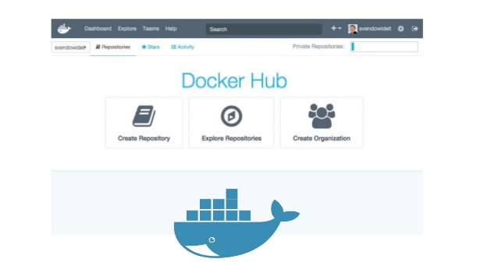


Docker Ecosystem
Container Engine
Manage Virtual Docker Hosts Remotely
Cloud-based Registry for Docker Images
Cluster and Scheduling Tool for Docker Containers
Helps Enterprises Deploy Their Own Docker Platforms
For Trusted Commercial (and Free) Software
Define and Run Multi-Container Docker Applications
Cloud Platform with Docker as a First Class Citizen (Like AWS…)
Storage and Content Delivery System (CDN) for Docker Images

Slide 55


Docker Volumes

Slide 56

Docker…. Reasons to Avoid
No Support (Windows 2012 or earlier)
Security and SLA’s
Lower-Level Infrastructure (e.g. AMI’s)
Young Platform (esp. on Windows)

Slide 57

Next Steps
Docker Volumes
Dockerfile
Docker Compose and Swarm
Docker in a CI/CD Pipeline

Slide 58



Docker Resources
https://app.pluralsight.com/library/courses/containers-images-big-picture/table-of-contents
https://app.pluralsight.com/library/courses/docker-deep-dive/table-of-contents
https://www.xenonstack.com/blog/docker-overview-a-complete-guide
https://docs.docker.com/get-started

Slide 59

Thanks!

